Slide 1

ANALYZING THE IMPACT OF CAR FEATURES
ON PRICE & PROFITABILITY

Slide 2
PROJECT DESCRIPTION :
Overview :
This project aims to analyze the relationship between various car features and their impact on the price and profitability of cars. By understanding these correlations, car manufacturers and dealers can make informed decisions on product development, marketing strategies, and pricing models.
Business Problem / Question :
The primary question this project addresses is: How do specific car features influence the price and profitability of cars? This includes examining factors like engine type, fuel efficiency, brand, body style, and technological features to determine their impact on the market value and profitability.
Description of the Data Sources:
The data used in this project is sourced from:
- Automotive Industry Databases: Comprehensive data on car features, prices, and sales figures.
- Manufacturer Reports: Information on production costs, profit margins, and technological
advancements.

Slide 3
- Market Surveys: Consumer preferences and willingness to pay for different car features.
Data Cleaning and Preprocessing Steps :
- Data Cleaning: Removed duplicates, handled missing values, and corrected any inconsistencies.
Normalization and Scaling: Standardized numerical data to ensure consistency and comparability across different features.
Assumptions Made During the Project :
- Market Stability: Assumed that the automotive market conditions remain relatively stable during the analysis period.
- Consumer Behavior: Assumed that consumer preferences for certain car features are consistent and not influenced by short-term trends.
By conducting this analysis, the project aims to provide actionable insights into how car features impact price and
profitability, ultimately helping stakeholders make data-driven decisions

Slide 4
APPROACH :
1. Analytical Methods:
- Descriptive Statistics: Utilized to summarize and understand the basic features of the data. This includes
measures of central tendency (mean, median), dispersion (standard deviation, range), and frequency distributions.
- Visualization: Employed various visual tools like bar charts, scatter plots to identify
patterns, correlations, and trends in the data.
2. Reasoning Behind Analytical Methods:
Descriptive Statistics: Chosen to provide a clear summary of the data and to identify any immediate insights or
anomalies.
Visualization: Selected to make the data more understandable and to reveal insights that are not immediately apparent from raw data.
3. Modeling Techniques:
- Linear Regression: Used for predicting car prices based on continuous variables.

Slide 5
4. Challenges and Limitations:
- Data Quality: Encountered issues with missing, inconsistent, or inaccurate data, which required
extensive cleaning and preprocessing.
- Feature Selection: Determining the most relevant features from a large dataset was challenging
and required careful analysis
- Assumptions: The analysis made several assumptions (e.g., market stability, consumer
behavior) that may not hold in all scenarios, potentially affecting the results.
This approach ensures a comprehensive analysis of how car features impact price and profitability, providing actionable insights for decision-makers in the automotive industry.
TECH-STACK USED:
1. Tools, Languages, and Software:
- Microsoft Excel 365: The primary tool used in this project for data analysis, visualization, and reporting. Excel
365 provides robust capabilities for handling large datasets, creating charts, and performing complex
calculations.

Slide 6
2. Reasoning Behind the Choice of Tech Stack:
Accessibility: Excel 365 is widely available and accessible, making it a practical choice for many users and stakeholders.
Functionality: Excel 365 offers a comprehensive suite of features including PivotTables, data analysis tools, and a variety of chart types, which are essential for detailed data exploration and visualization.
Ease of Use: Excel's user-friendly interface allows for efficient data manipulation and analysis without the need for extensive programming knowledge.
3. Additional Libraries :
Excel Add-ins: Various Excel add-ins, such as the Analysis ToolPak, were employed to extend Excel’s functionality and provide additional analytical tools.
By leveraging Microsoft Excel 365 and its powerful features, this project ensures comprehensive data analysis and effective visualization of insights. The chosen tech stack provides the necessary capabilities to explore and understand the impact of car features on price and profitability.

Slide 7
INSIGHTS:
1. Key Insights:
- Feature Impact on Price: Luxury features such as high horsepower, advanced technology (e.g., autopilot), and
premium interiors significantly increase car prices.
- Fuel Efficiency and Price: Cars with higher fuel efficiency, such as electric and hybrid vehicles, tend to have
higher initial prices but lower long-term costs, which can enhance profitability.
- Brand Influence: Premium brands like Bugatti and Maybach command higher prices due to their reputation,
performance, and exclusivity. In contrast, brands like Plymouth and Oldsmobile have lower average prices.
- Body Style Preferences: Convertibles and coupes are priced higher due to their sporty appeal and lower
production volumes. Conversely, more practical body styles like SUVs and hatchbacks are priced more
affordably.

Slide 8
2. Explanation of Insights Relating to Business Problem:
- Price Determination: Understanding how specific features influence car prices helps manufacturers set
competitive yet profitable pricing strategies.
- Targeted Marketing: Insights into fuel efficiency and brand influence enable targeted marketing campaigns that
highlight the unique selling points of each model.
- Product Development: Knowledge of body style preferences and feature demand assists in making informed
decisions regarding new model development and feature enhancements.
3. Recommendations and Conclusions:
- Focus on Premium Features: Manufacturers should invest in developing and marketing premium features that
justify higher prices, such as advanced technology and superior performance.
- Promote Fuel Efficiency: Highlighting the long-term cost savings and environmental benefits of fuel-efficient
models can attract environmentally conscious customers and justify higher prices.

Slide 9
- Leverage Brand Strength: Premium brands should leverage their reputation to maintain high prices, while more
affordable brands can focus on value for money and practicality.
- Diversify Body Styles: Offering a diverse range of body styles, including sporty and practical options, can cater to
a broader market and enhance overall sales.
By leveraging these insights, automotive manufacturers and dealers can make data-driven decisions to optimize pricing, enhance profitability, and meet consumer demands effectively.
RESULT :
1.Visualization of the Results:
Visual representations were created using Microsoft Excel 365 to clearly illustrate the findings:
- Tables: Summarize the average prices and fuel efficiencies of different car models and features.
- Graphs: Include bar charts showing the average prices by car brands, scatter plots displaying the relationship
between horsepower and price, and pie charts representing the distribution of various body styles.
- Dashboards: Interactive dashboards in Excel aggregate these visualizations, providing an easy-to-navigate interface
for exploring the data.

Slide 10
2.Discussion of the Results and Their Implications:
Impact of Features on Price: The analysis highlighted that premium features such as high horsepower, advanced
technology, and luxurious interiors substantially raise car prices.
Fuel Efficiency: Cars with higher fuel efficiency, particularly electric and hybrid models, have higher initial prices
but lower running costs, which enhance profitability over time.
Brand Influence: Premium brands like Bugatti and Tesla command higher prices due to their reputation for
performance and innovation, whereas brands like Plymouth and Oldsmobile are more affordable.
Body Style Preferences: Convertibles and coupes are more expensive due to their sporty appeal, while practical
options like SUVs and hatchbacks are more budget- friendly.
3.Limitations or Uncertainties:
Data Quality: The accuracy of the analysis relies heavily on the quality of the data used. Inconsistent or incomplete data could skew the results.

Slide 11
4. Future Directions or Additional Analysis:
- Expanded Dataset: Incorporating additional data points, such as maintenance costs and resale values, could
provide a more comprehensive analysis.
- Advanced Machine Learning: Utilizing more sophisticated machine learning algorithms, such as neural networks,
could improve predictive accuracy.
- Longitudinal Studies: Conducting time-series analysis to observe trends over multiple years would offer deeper
insights into market dynamics.
- Customer Sentiment Analysis: Analyzing customer reviews and feedback could provide qualitative insights into
consumer preferences and satisfaction.
By clearly presenting the results, discussing their implications, and acknowledging limitations, this project offers valuable insights into how car features impact price and profitability. The findings can help stakeholders make informed, data-driven decisions in the automotive industry.

Slide 12
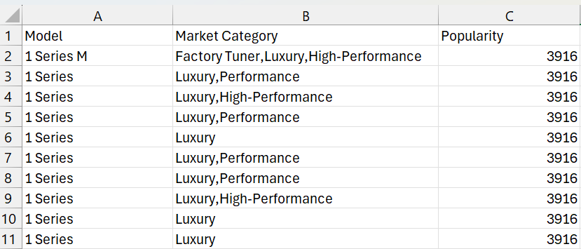
ANALYSIS :
TO FIND POPULARITY OF A CAR MODEL VARY ACROSS DIFFERENT MARKET CATEGORIES
First we have to use pivot table to find the popularity of a car model across different market categories
The columns used to create a pivot table are Model.Market category &Popularity columns

Slide 13
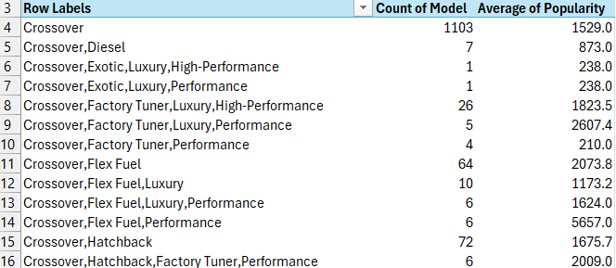
The pivot table created :
The Combo chart is created to visualize the relationship between market category & popularity using the pivot table columns

Slide 14
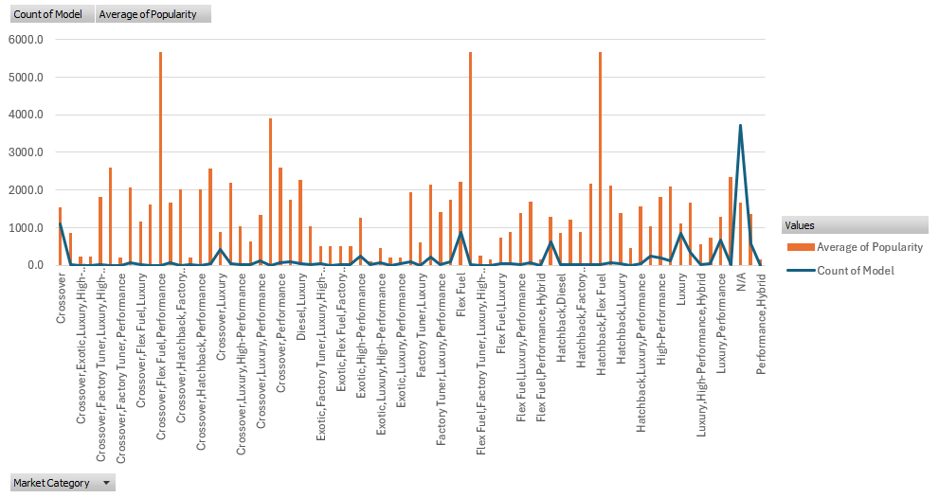
The combo chart created :
The gretest popularity was for “ crossover.Flex,fuel,performance”,”Flex Fuel,Diesel”,”Hatchback,Flex Fuel” markets
This concludes that the varied degrees of popularity of different automobile modes in different market segments offers insights into customer preferences in this sector.

Slide 15
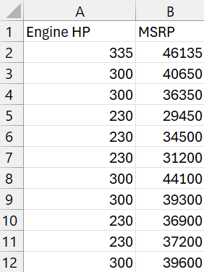
TO FIND THE RELATIONSHIP BETWEEN A CAR'S ENGINE POWER AND ITS PRICE
First we have to use The scatter plot to find the relationship between a car’s engine power & its price
The columns used to plot scatter plot are engine HP & MSRP columns

Slide 16
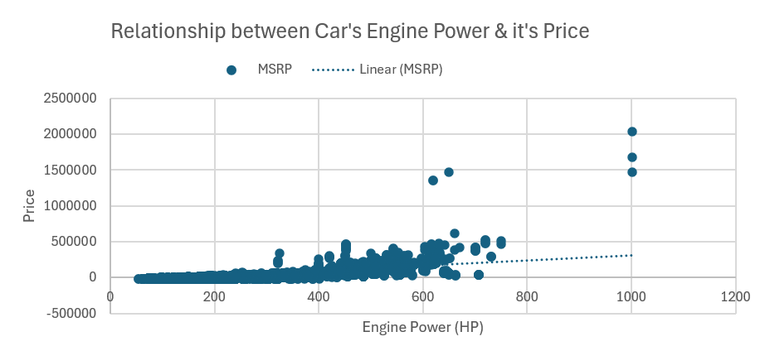
The scatter plot is created to visualize the relationship between engine power & price using the columns Engine HP & MSRP
The scatter plot created :

Slide 17
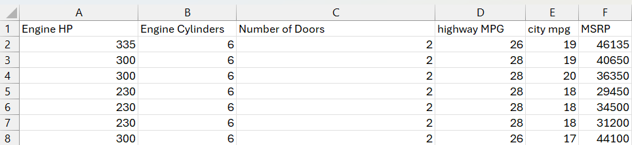
The scatter plot shows a general upward trend. This indicates that as the engine power of a car increases, its price also tends to increase.
Correlation: The trendline further supports this positive correlation. The upward slope of the trendline suggests that there's a positive association between engine power and price.
The scatter plot reveals a positive correlation between engine power and price, meaning that generally, cars with higher engine power tend to be more expensive. However, the spread of data points indicates that other factors also contribute to the price variation.
TO FIND WHICH CAR FEATURES ARE MOST IMPORTANT IN DETERMINING A CAR'S PRICE?
To find that first we use Regression analysis to identify the variables that have the strongest relationship with a car's price
The columns used to do regression analysis are Engine HP,Engine Cylinders,Number of Doors,Highway MPG,City Mpg,MSRP columns

Slide 18
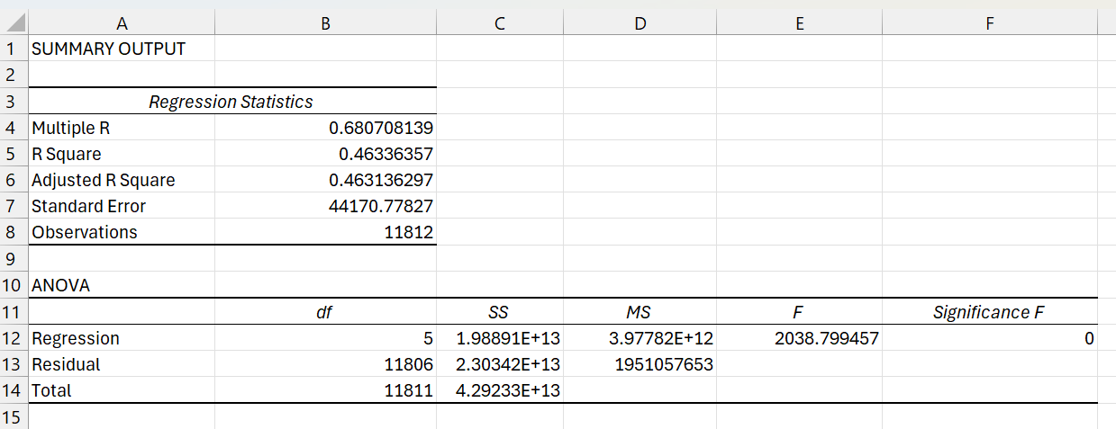
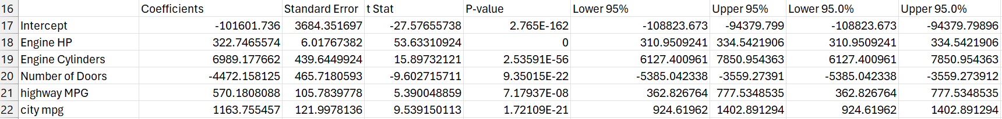
The Regression Analysis which is performed on Engine HP,Engine Cylinders,Number of Doors,Highway MPG,City Mpg,MSRP columns :

Slide 19
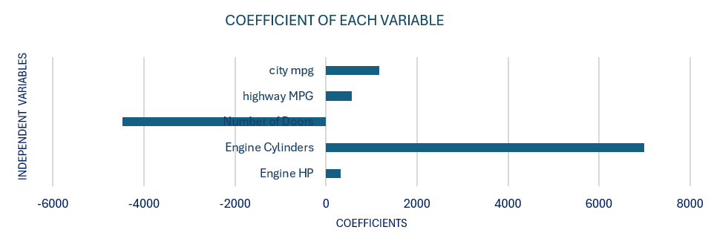
A bar chart is created to visualize the variables relative importance & the bar chart is created using columns Engine HP, Engine cylinders ,no of doors, highway MPG,city MPG& MSRP
The bar chart created :
- Engine Cylinders: With a high coefficient of 6989.177662 , the number of engine cylinders has the largest correlation with a car's price. This means that as the number of engine cylinders increases, the car's price tends to be higher.
- Number of Doors: This factor has a negative coefficient of -4472.158125, indicating that it has the least correlation with car pricing. More doors are associated with a decrease in the car's price.
the price of a car is mostly influenced by the number of engine cylinders, whereas the number of doors has a minimal impact.

Slide 20
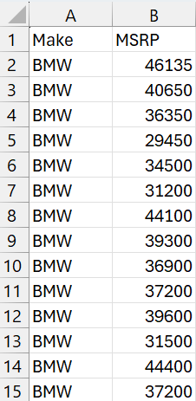
TO FIND HOW DOES THE AVERAGE PRICE OF A CAR VARY ACROSS DIFFERENT MANUFACTURERS
To find that first we have to use pivot table to visualize the average price of the cars for each manufacturer
The columns taken to create the pivot table are Make ,MSRP columns

Slide 21
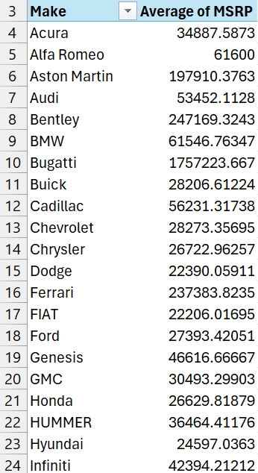
The pivot table created :

Slide 22
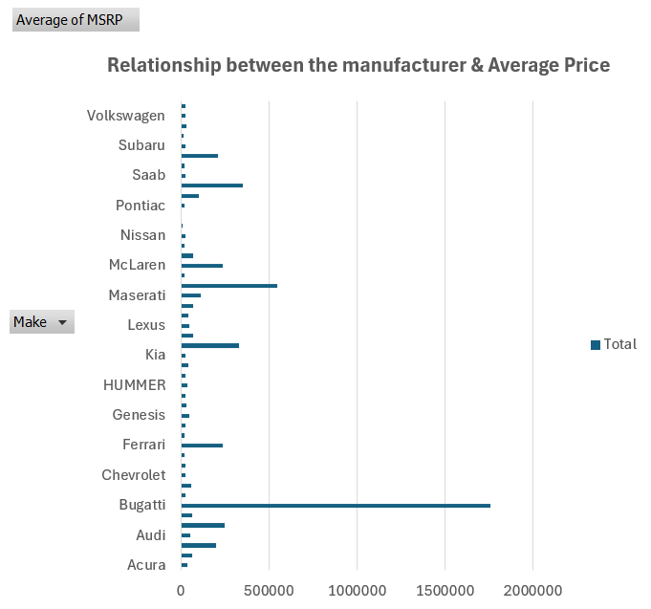
A bar chart is created to visualize the relationship between manufacturer and average price using the pivot table columns .
The bar chart created :

Slide 23
- Bugatti: Has the highest average price of any brand, which is $1,757,223.667
- Maybach: Follows with an average price of $546,221.875
This information can help car manufacturers with pricing and positioning initiatives.
By analyzing average car prices, manufacturers can gain insights into the automotive industry's pricing landscape. This helps them position their products strategically, adjust pricing to align with consumer expectations and competitor prices, and ultimately enhance their competitiveness and profitability.
TO FIND THE RELATIONSHIP BETWEEN FUEL EFFICIENCY AND THE NUMBER OF CYLINDERS IN A
CAR’S ENGINE
To do that we have to use scatter plot to visualize the relationship between the no of cylinders & highway MPG
and use a trendline to estimate the slope of the relationship and assess its significance

Slide 24
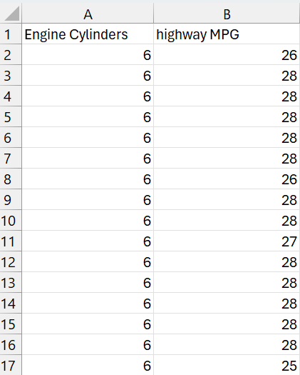
The Columns used to plot a scatter plot are Engine Cylinders & Highway MPG columns

Slide 25
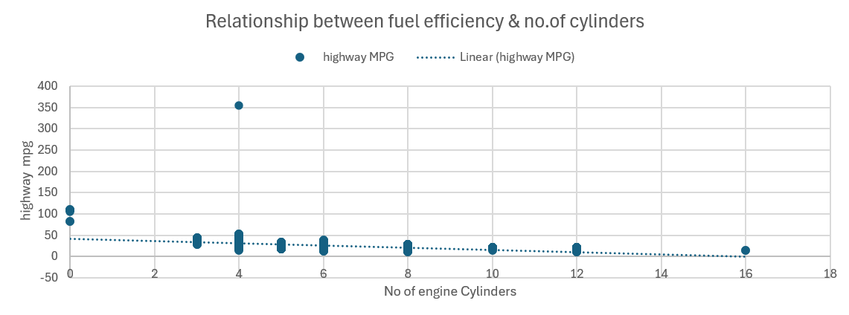
A scatter plot is created to visualize the relationship between the no of cylinders & highway MPG and a trendline on the scatter plot is created to estimate the slope of the relationship and assess its significance & the scatter plot is created using Engine cylinder & Highway MPG columns
The scatter plot created :

Slide 26
the correlation coefficient is found between the number of cylinders and highway MPG to quantify the strength and direction of the relationship.
The Correlation Coefficient of Engine Cylinders & Highway MPG column is found using CORREL function :
= CORREL(A2:A11813,B2:B11813)
= -0.620312551
The Correlation Coefficient of Engine Cylinders & Highway MPG column is -0.620312551
The investigation shows a negative relationship between highway MPG and the number of engine cylinders, meaning that as the cylinder count increases, highway MPG decreases. For example, cars with 16 cylinders have the lowest highway MPG of 14 illustrating the impact of engine capacity on fuel economy.
A correlation coefficient of -0.62 confirms this significant negative relationship, indicating that higher cylinder counts generally lead to lower highway fuel efficiency.
This analysis quantifies how higher cylinder counts typically result in lower highway fuel efficiency.

Slide 27
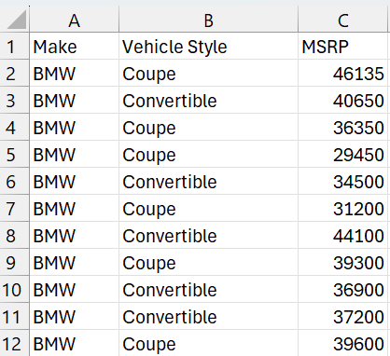
BUILDING THE DASHBOARD :
TO FIND HOW DOES THE DISTRIBUTION OF CAR PRICES VARY BY BRAND AND BODY STYLE
To find that first we have to use pivot tables to find the total MSRP for each brand and body style
The columns used to create pivot tables are Make,Vehicle Style,MSRP columns

Slide 28
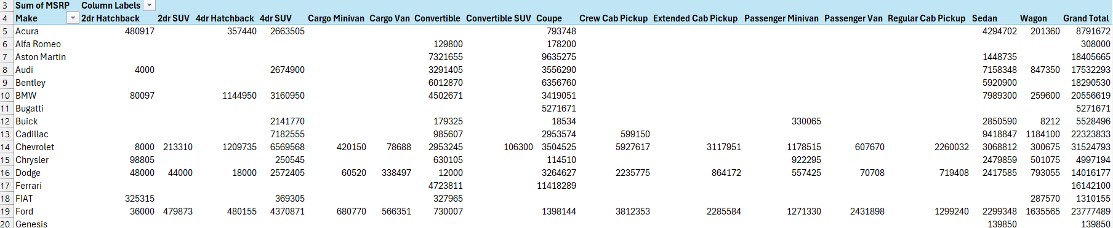
The pivot table created :

Slide 29
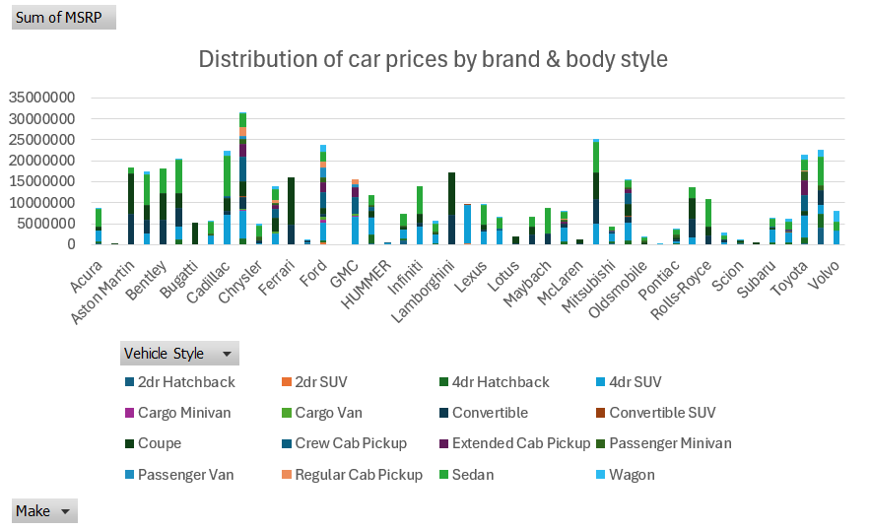
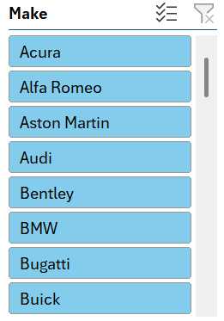
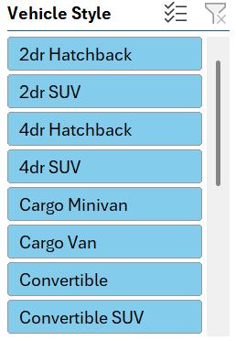
Stacked column chart is created to show the distribution of car prices by brand and body style and slicers are used to make the chart interactive and Stacked column chart is created using the pivot table columns
Stacked column is created with sliders :

Slide 30
Chevrolet leads with the highest total prices amounting to $31524793
- Mercedes-Benz follows with a total price of $25181309
- Sedan have the highest total cost among car types, totaling $117474790
- Four-door SUV come next with a total of $100258517
These insights are valuable for the car industry's marketing strategies, product development, and pricing decisions.
TO FIND WHICH CAR BRANDS HAVE THE HIGHEST AND LOWEST AVERAGE MSRPS, AND HOW DOES THIS VARY BY BODY STYLE
To find that first we have to use Pivot tables to find the average MSRP for each brand and body style

Slide 31
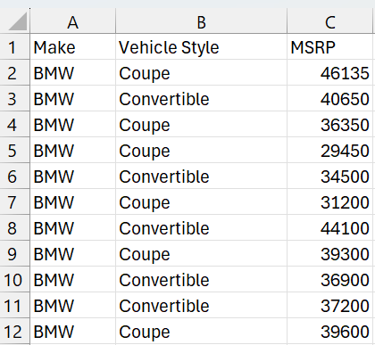
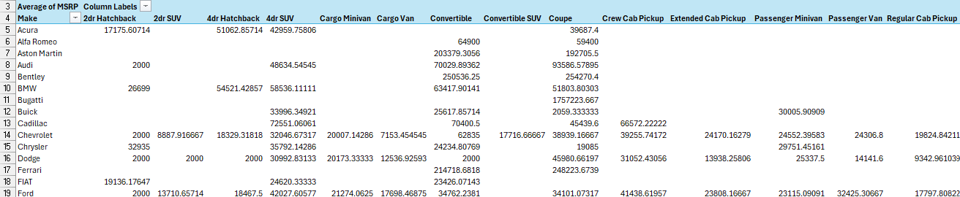
The columns used to create pivot table are Make,Vehicle Style & MSRP columns
The pivot table created :

Slide 32
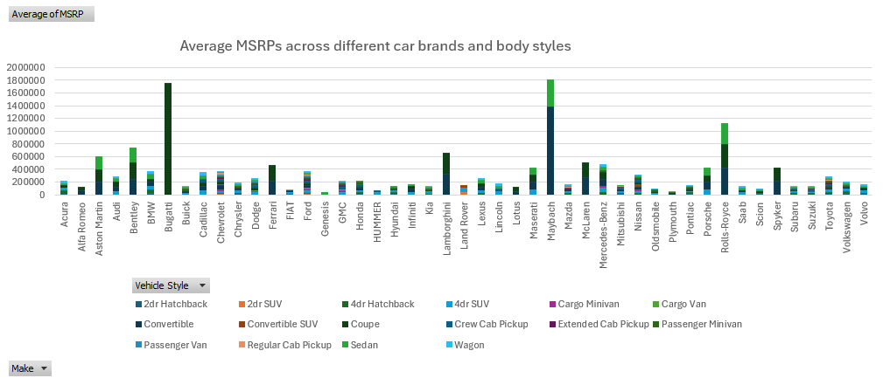
The Clustered column chart is created to compare the average MSRPs across different car brands and body styles and Clustered column chart is created using the pivot table columns
The clustered column chart created :

Slide 33
Brand Analysis:
- Bugatti : Highest average price of $1757223.667
- Maybach: Second highest average price at $546221.875
- Plymouth: Lowest average price per brand at $3122.902439
- Oldsmobile: Second lowest average price at $11542.54
- Body Style Analysis:
- Convertibles: Highest average price at $84224.28499
- Coupes: Second highest average price at $76900.70504
- 2-door SUVs: Most affordable at $. 10115.18841
- 2-door Hatchbacks: Second most affordable at $16778.65408
This research provides valuable insights into price patterns across various car markets.

Slide 34
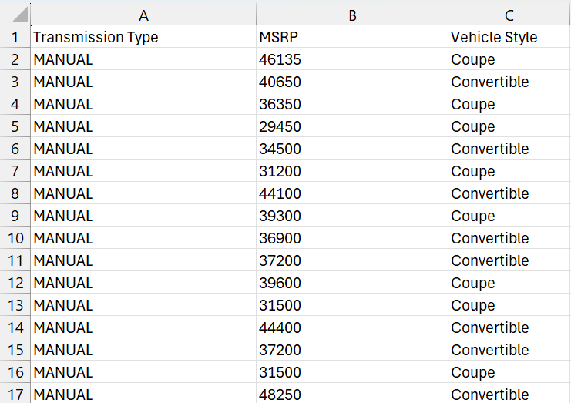
TO FIND HOW DOES DIFFERENT FEATURE SUCH AS TRANSMISSION TYPE
AFFECT THE MSRP, AND HOW DOES THIS VARY BY BODY STYLE?
.
To find that first we have to use Pivot tables to find the average MSRP for each combination of transmission type and body style
The columns used to create pivot tables are Transmission type ,MSRP & vehicle style columns

Slide 35
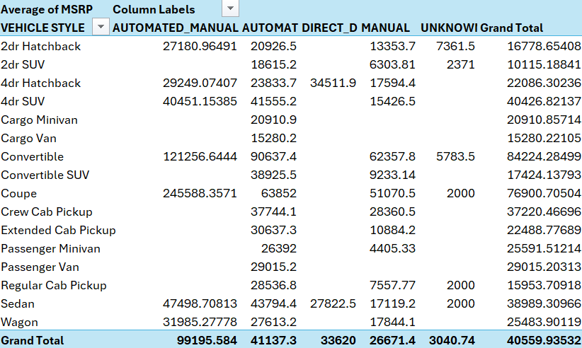
The pivot table created :
.

Slide 36
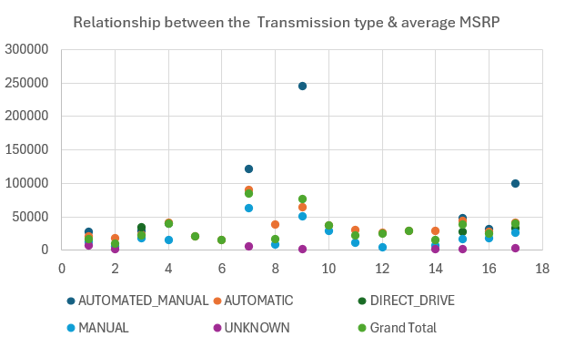
Scatter plot chart is created to visualize the relationship between MSRP and transmission type, with different symbols for each body style and the scatter plot chart is created using the pivot table columns
The scatter plot chart created :

Slide 37
Transmission Types
- Direct Drive: Average price of $33620
- Automated Manual: Highest average price at $99195.584
- Manual : Second highest average price at $26671.4
Unknown: Lowest average price at $3040.737
Body Shapes
- Coupes: Average price of $76900.70504
- Convertibles: Highest average price at $84224.28499
- 2-Door SUVs: Least expensive at $10115.18841
- 2-Door Hatchbacks: Next most affordable at $16778.65408

Slide 38
These insights provide useful information for understanding price trends in the car industry across various body shapes and gearbox types.
When considering transmission types, automated manual transmission has the highest average price, closely followed by direct drive transmission. In terms of body shape, convertibles have the highest average price, with coupes .Manual transmission ranks second, while unknown transmission has the lowest average price. Among body shapes, 2-door SUVs are the least expensive, followed by 2-door hatchbacks.

Slide 39
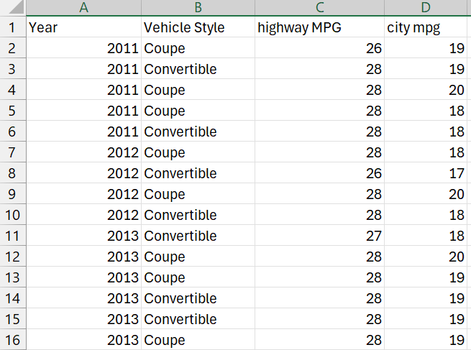
TO FIND HOW THE FUEL EFFICIENCY OF CARS VARY ACROSS DIFFERENT BODY STYLES AND MODEL YEARS
.
To find that first we have to use Pivot tables to find the average MPG for each combination of body style and model year
The columns used to create pivot table are Year, vehicle style, Highway MPG & city MPG columns

Slide 40
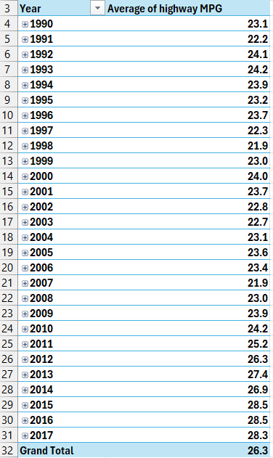
The pivot table created :
.

Slide 41
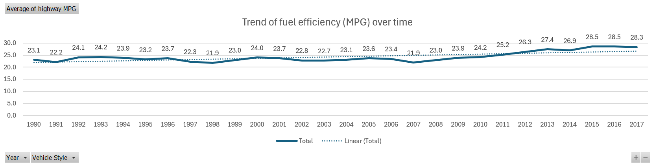
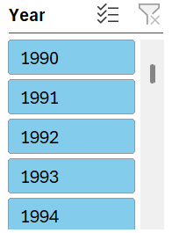
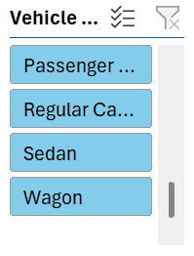
Line chart is created to visualize the trend of fuel efficiency (MPG) over time for each body style and the line chart is created using the pivot table columns
.
The line chart created with Sliders :

Slide 42
The data indicates a trend of increased fuel efficiency as car model years progress, likely due to advancements in automotive technology and regulations focused on reducing emissions and enhancing fuel economy. In 2016, the highest average highway fuel efficiency, with an average MPG was 28.5 , achieved by four-door hatchbacks, reflecting efforts to improve fuel efficiency. Conversely, cargo vans had the lowest average highway MPG at 16, highlighting variations in fuel efficiency across different vehicle categories.

Slide 43
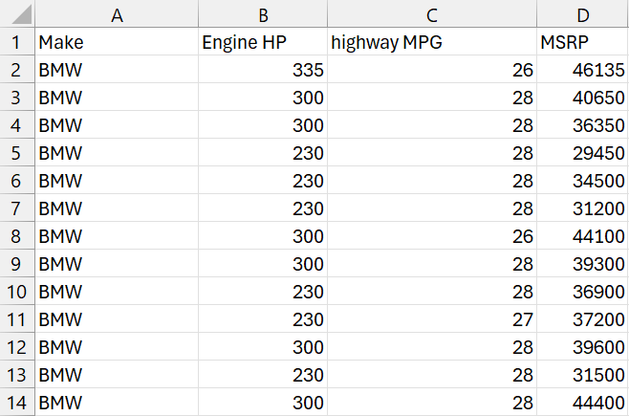
TO FIND THE CAR'S HORSEPOWER, MPG, AND PRICE VARY ACROSS DIFFERENT BRANDS
To find that first we have to use pivot tables to find average horsepower, MPG, and MSRP for each car brand
The columns used to create pivot table are Make,Engine HP,Highway MPG,MSRP columns

Slide 44
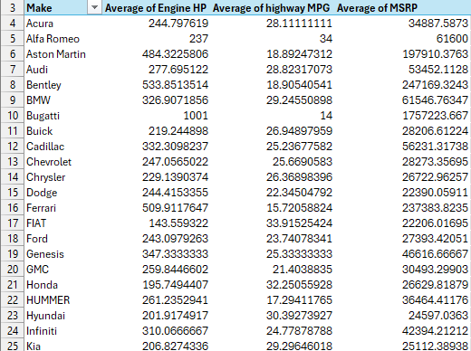
The pivot table created :

Slide 45
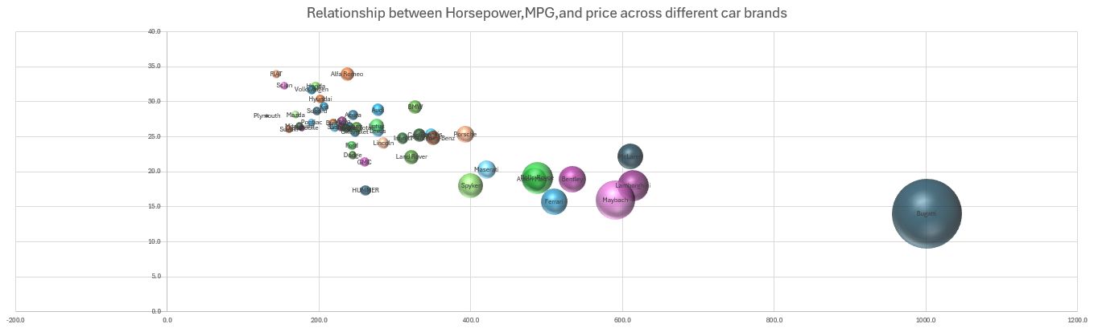
The Bubble chart is created to visualize the relationship between horsepower, MPG, and price across different car brands. different colors has been assigned to each brand and lthe bubbles have been labelled with the car model name. and the bubble chart is created using pivot table columns
the bubble chart created :

Slide 46
Brand Comparison
Bugatti:
- Greatest Average Engine Horsepower: 1001
- Highest Average Price: $ 1757223.667
- Highest Average Highway MPG : 14
Alfa Romeo:
- Highest Average Highway MPG: 34
- Greatest Average Engine Horsepower: 237
- Highest Average Price: $ 61600
- Bugatti is Known for high-performance cars with top-tier engine power and pricing, appealing to those seeking unmatched performance.
- Alfa Romeo emphasizes performance and style, with a range of gasoline and plug-in hybrid vehicles. They offer powerful engines and sporty designs, appealing to those who enjoy driving dynamics.

Slide 47
Alfa Romeo appeals to driving enthusiasts who value performance and design.
The comparison illustrates different goals and preferences within the automobile industry, catering to a broad spectrum of customers with varying requirements and interests.

Slide 48
TO CREATE A INTERACTIVE DASHBOARD :
To create a interactive dashboard filters & sliders are used in the dashboard
The interactive dashboard is created by combining all the last 5 charts which are :
Distribution of car prices by brand & body style Chart
Trend of Fuel efficiency over Time Chart
Average MSRPs across different car brands & body styles Chart
Relationship between Transmission type & average MSRP Chart
Relationship between Horsepower, MPG and price across different car brands chart
Along with their respective sliders attached and the necessary filters can be applied

Slide 49
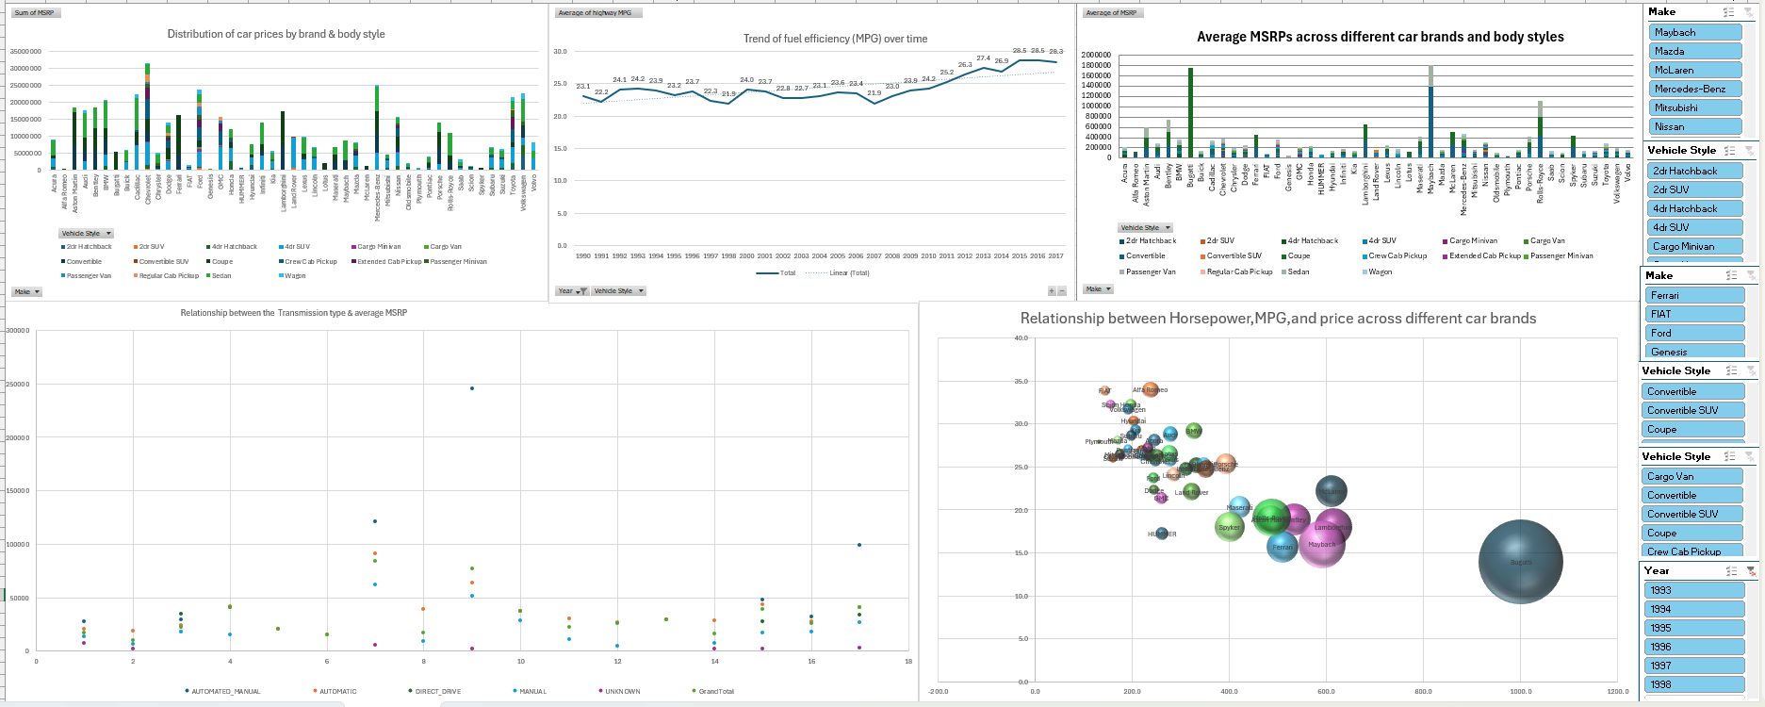
The interactive dashboard created :

